Slide 1
National Guideline for the
Field Triage of Injured Patients

Slide 2
Presenter Name
Credentials
Affiliation
Notes:
Modifications to the PowerPoint are allowed to include the addition of local resources. Changes to the guideline graphic or any logo copyrighted by ACS are not allowed.

Slide 3
Objectives
Describe the update process
Explain the new Guideline
Discuss the changes from the 2011 Guideline
Review local & regional use of the Guideline

Slide 4
Remember
Follow your local protocol & medical director guidance

Slide 5
Why a guideline?
Achieve optimal patient outcomes through transport to most appropriate destination within the trauma system
Right Patient, Right Place, Right Time
Minimize variation in destination decisions
Notes:
For three decades, the Guideline has been widely adopted by trauma systems in the United States to support decision making by EMS clinicians in transport destination determinations for injured patients. The goal has been to ensure that seriously injured patients are transported to the most clinically appropriate trauma centers.
The Guideline helps to minimize variation in destination decisions.

Slide 6
Why an update?
New research and evidence since 2011 Guideline
Reduce time and variation in making destination decisions
Opportunity to reduce under- & over-triage
Notes:
New & updated research on field triage guidelines
Research related to the predictive utility of out-of-hospital motor Glasgow Coma Scale (GCS) score versus total GCS and other measures of mental status, circulatory measures, respiratory measures, mechanism of injury and special considerations criteria, and the overall performance of the triage guideline.
Reduction in time to making destination decision – faster to “call the trauma code”
Opportunity to reduce under-/over-triage
Under-triage is the percentage of seriously injured patients missed by field triage processes and transported to non-trauma hospitals, which is associated with increased mortality in adults and children.
Over-triage is the percentage of patients with minor to moderate injuries identified by field triage criteria as having serious injury and transported to trauma centers unnecessarily, representing overuse of limited resources and inefficiency in the system.
Under- and over-triage are inversely related and can have a large impact on ambulance transport patterns and hospital volumes.

Slide 7
Update Process
Inclusion of EMS input
  Survey distributed to 29 national organizations representing EMS and trauma
  3,958 Responses
Interdisciplinary national Expert Panel
Systematic reviews of EMS field triage and other relevant published literature
Rigorous process for adding or removing criteria
Notes:
Process has taken 2 years.
The Expert Panel included EMS clinicians, emergency physicians, trauma surgeons, nurses, EMS medical directors, EMS educators, EMS & trauma system administrators, systems experts, & representatives from stakeholder organizations.
Manuscript outlines the literature review & criteria for adding/deleting/modifying the criteria.
Survey sent to 29 national organizations with 3,958 responses received.
A statistical process for adding or removing criteria was developed by experts in predictive analytics and guideline development. The addition and removal of criterion was guided by rigorous, consistent criteria including likelihood ratios and AUROC (Area Under the Receiver Characteristic Curve).

Slide 8
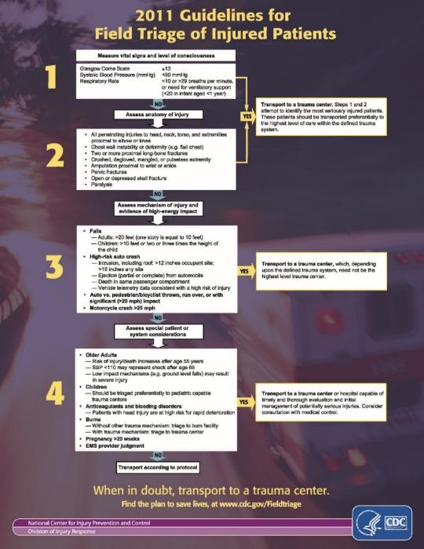
2011 Guideline
Assess vital signs & level of consciousness
Assess anatomy of injury
Assess mechanism of injury & evidence of high energy impact
Assess special patient or system considerations
Notes:
Should be familiar to all!

Slide 9
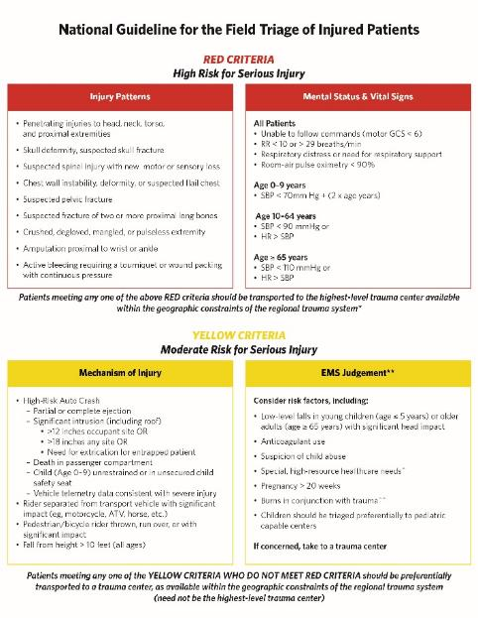
What’s new?
Not an algorithm
Simplified to align with information flow to EMS
Reflect how assessments occur on the scene
Gets to transport decision sooner
Notes:
Framework: move from algorithm of four sequential steps to two tiers based on how EMS professionals work at the scene
Characteristics:
Accessible & simple
Aligns with awareness of system capabilities
3. Gets to “yes” in trauma center disposition as quickly as possible

Slide 10
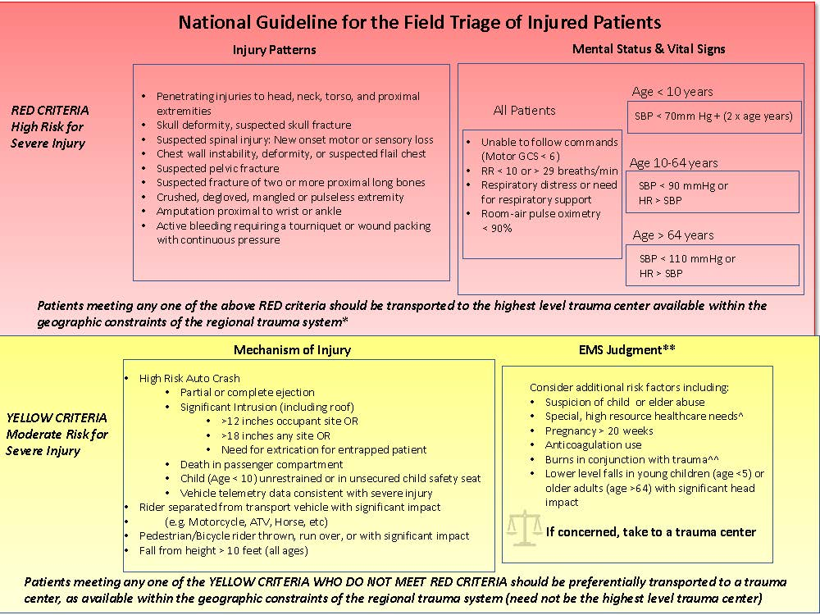
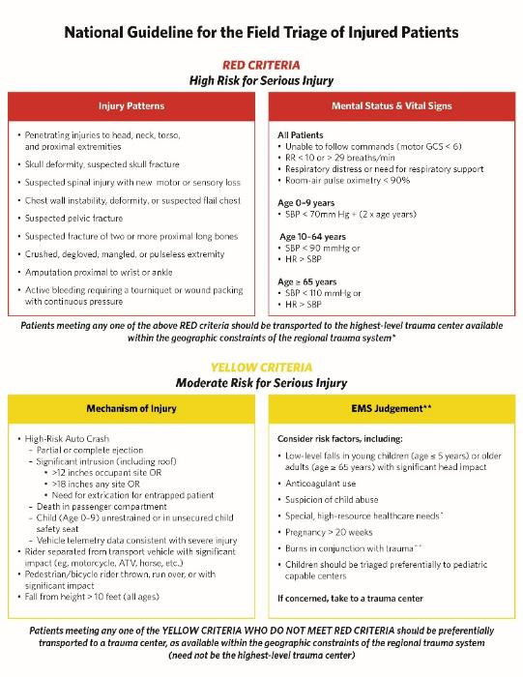
New Guideline
Flow of information to EMS
Risk
Guideline is intended to be read from left to right and top to bottom
Evidence along gradient of likelihood for serious injury
Notes:
First tier: high risk for serious injury, transport to highest level trauma center available
1. Injury patterns: rapid visual markers
2. Mental status & vital signs: physiologic indicators
Second tier: moderate risk for serious injury, transport to nearest trauma center (not necessarily the highest level)
1. Mechanism of injury
2. EMS judgment

Slide 11
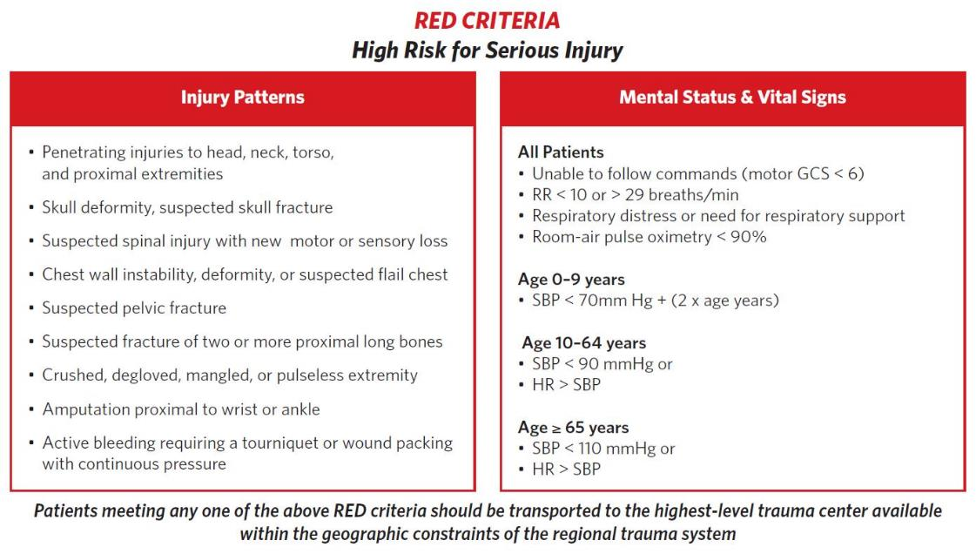
Notes:
Red category: left to right, injury patterns and mental status/vital signs
Patients to go to the highest-level care available
ALS intercept?
Air?

Slide 12
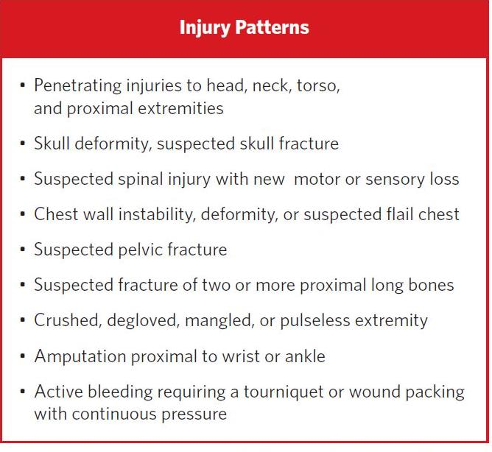
Notes:
Content – Injury Patterns
New
Active bleeding requiring a tourniquet or wound packing with continuous pressure
Clarified – re-worded
Penetrating injuries to the head, neck, torso, & proximal extremities (took out to elbow & knee)
Skull deformity, suspected skull fracture (no “open or depressed”)
Suspected spinal injury with new motor or sensory loss (instead of paralysis)
Chest wall instability, deformity or suspected flail chest (added “suspected”)
Suspected pelvic fracture (added “suspected”)
Suspected fracture of two or more proximal long bones (added “suspected”)
Retained
Crushed, degloved, mangled, or pulseless extremity
Amputation proximal to wrist or ankle

Slide 13

Age-related changes to vital signs have been added
Source: Getty Images. Used with permission
Notes:
Rather than one set of vital signs, there are now different sets for adult, pediatric, and geriatric. These are outlined on the next slide.

Slide 14
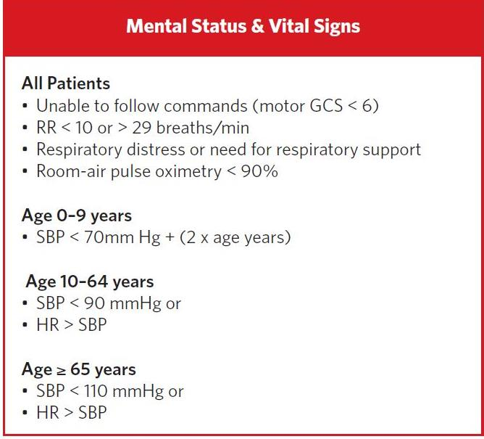
Notes:
New
Heart rate > SBP for adults
Respiratory distress or need for respiratory support
Room-air pulse oximetry < 90 mmHg
Modified
Motor GCS < 6 (was overall less than 13 but now no calculations needed. “Can you look at me?” If they can, passes, if not – transport)
SBP < 70 mmHg + (2 x age), for children 0-9 years (added as different from adult)
Retained
SBP < 90 mmHg & < 110 in older adults
RR < 10 or > 29 breaths/minute

Slide 15
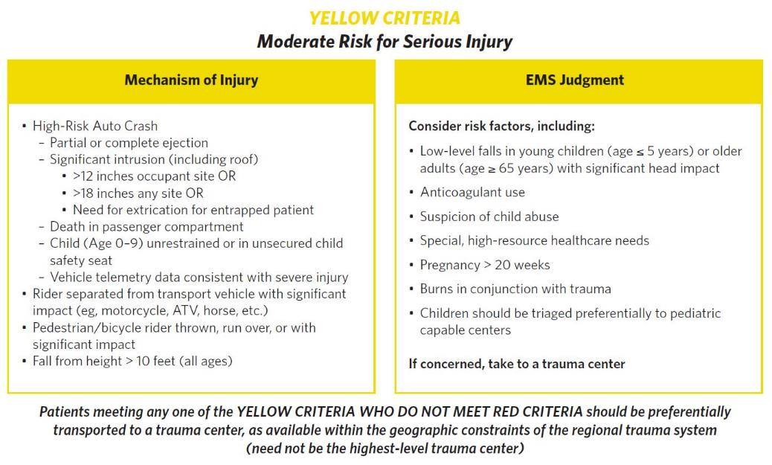
Notes:
Yellow category: left to right, starts with mechanism of injury and proceeds to EMS judgment
Patients to go to the nearest trauma center

Slide 16
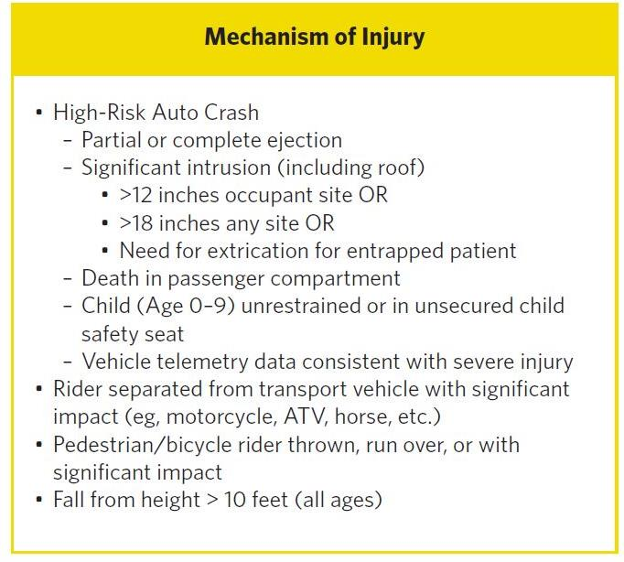
Extrication relates to entrapment, not simple confinement
Notes:
New
Child (Age 0-9 years) unrestrained or in unsecured child safety seat
Modified
Significant intrusion (including roof) > 12 inches occupant site or > 18 inches any site or need for extrication of the entrapped patient (added extrication)
“Extrication” does not include simple confinement. For example, cutting a post or popping a door to gain access for an otherwise stable patient who is unable to open a door is NOT extrication. Extrication here is more complex involving time greater than 5 minutes and/or impingement on the patient. Entrapment is not confinement.
Rider separated from transport vehicle – not just “ejection from automobile”
Fall from height > 10 feet (all ages now instead of different heights or “times the height of…”)
Clarified: pedestrian/Bicycle rider thrown, run over, or with significant impact (no speed limit)
Retained
Ejection (partial or complete) from automobile
Death in passenger compartment
Vehicle telemetry data consistent with severe injury

Slide 17
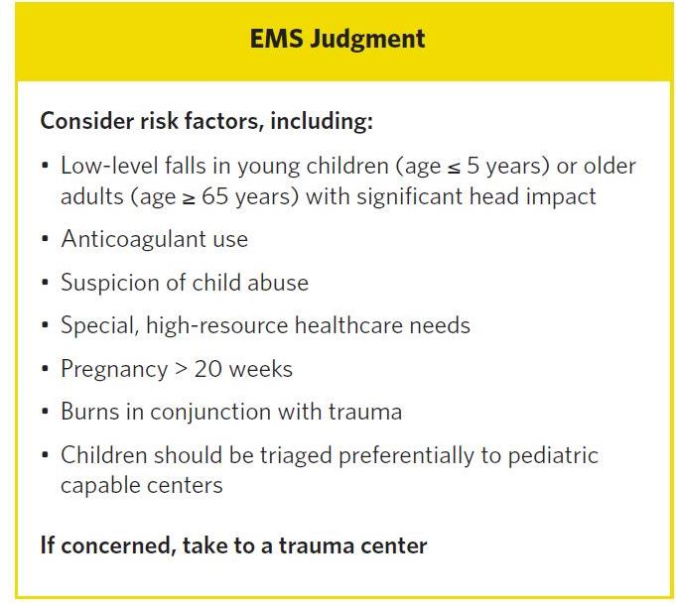
Notes:
New
Low level falls in young children (age ≤ 5 years) or older adults (age ≥ 65 years) with significant head impact
Suspicion of child abuse
Special, high resource healthcare needs
Modified
Anticoagulation use (all trauma, not just head injuries)
Retained
Pregnancy > 20 weeks
Burns in conjunction with trauma
Children should be triaged preferentially to pediatric capable trauma centers
As always, if concerned take to a trauma center

Slide 18
Applying the Guideline
Appreciate and understand the context
Know your local and regional trauma resources
Encourage adoption by local and state EMS agencies
Sustain education and training
Track use and outcomes through performance improvement
Notes:
Appreciate the context
Not for mass casualties
This is a field triage guideline for prehospital use
Know your local and regional trauma resources
What are the possible patient destinations and trauma capabilities?
Encourage adoption by local and state EMS agencies
Sustain education and training
Individual & group initial training on the new guideline
Use posters, protocols, & badge cards
Refresh knowledge as part of your continuing education
Track use and outcomes through performance improvement
Review over- & under-triage by criteria
Inform sustainment training

Slide 19
Encourage Adoption
Educator: insert graphic or info on your
local/state/regional trauma system
Notes:
Encourage adoption by local & state EMS agencies, as well as regional & state trauma systems
Get everyone on the same page!

Slide 20
Local & Regional Resources
Educator: insert map of local or regional trauma centers
Notes:
Discuss local trauma centers, designations (differences), & capabilities
May have state map with distance to trauma centers

Slide 21
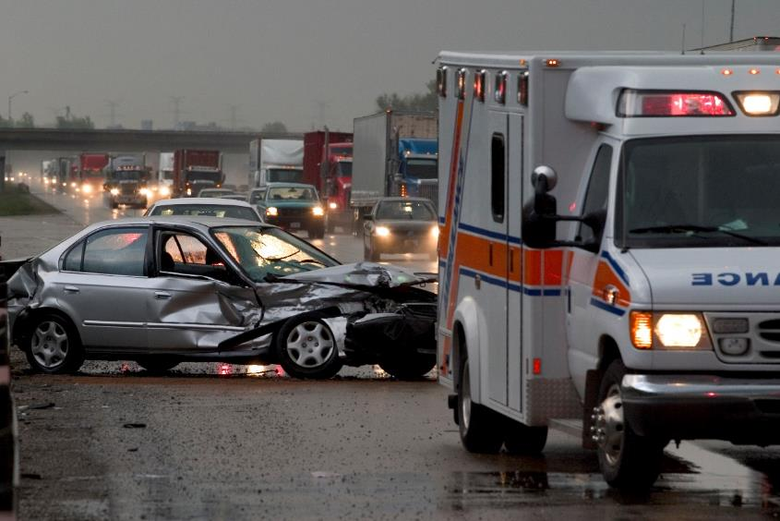
Transport According to Local Protocol
Source: Getty Images. Used with permission
Notes:
Discuss local protocol or state guidelines/requirements for EMS transport plans

Slide 22
ALS Intercepts & Air Assets
Educator: insert map of local ALS intercepting agencies &/or air assets.
May also show local protocols on using those, or other, assets.
Notes:
Discuss local protocols on ALS intercepts & air activation. How does this guideline impact those?
When will these services auto-deploy in your area?

Slide 23
Summary
Update process inclusive of EMS clinician input
New guideline aligns with information flow to EMS and how assessments occur on the scene
Guideline use is best assessed through impact on under- & over-triage rates

Slide 24
Questions?
Notes:
May add presenter contact info as appropriate

